Slide 1

Chapter 3 (cont.)
Design Theory for Relational Databases

Slide 2
II.
Decomposition

Slide 3
2.1. Decomposition
The accepted way to eliminate anomalies is the decomposition of relations
Decomposition of a relation R involves splitting the attributes of R to make the schemas of 2 new relations

Slide 4
2.1. Decomposition
Definition:
Given a relation R(A₁,..,A_{n}), we say R is decomposed into S(B₁,..,B_{m}) and T(C₁,..,C_{k}) if: + {A₁,..,A_{n}} = {B₁,..,B_{m}} U {C₁,..,C_{k}} + S = ∏_{B1,..Bm}(R) + T = ∏_{C1,..,Ck}(R)

Slide 5
Example: Decomposition

Slide 6
Discuss
The redundancy is eliminated (the length of each film appears only once)
The risk of an update anomaly is gone (we only have to change the length of Star Wars in one tuple)
The risk of a deletion anomaly is gone (if we delete all the stars for Gone with the wind, that deletion makes the movie disappear from the right but still be found in the left)

Slide 7
The Good & Bad
2.1. Decomposition
We observed that before we decompose a relation schema into BCNF, it can exhibit anomalies; That’s the “Good”
However, decomposition can also have some bad:
Maybe we can’t recovery the original information; OR
After reconstruction, the FDs maybe not hold

Slide 8
Example: Loss of information after decomposition
Suppose we have R(A,B,C) but neither of the FD’s B->A nor B->C holds.
R is decomposed into R1 and R2 as above
When we try to re-construct R by Natural Join of R1 and R2, we have: R3 = R1 X R2 (but R3 <> R1 => We lost information)

Slide 9
Example: Dependency Loss
If we check the projected FD’s in the relations of the decomposition, can we can be sure that when we reconstruct the original relation from the decomposition by joining, the result will satisfy the original FD’s?

Slide 10
Normalization

Slide 11
III.1. Definitions
Multivalued Attributes (thuộc tính đa trị)
Atomic values (thuộc tính nguyên tố)
non-key attribute (thuộc tính không khoá)
Partial Dependency (phụ thuộc bộ phận)
Transitive Dependency (phụ thuộc bắc cầu)

Slide 12
1. Multivalued Attributes
Multivalued Attributes (or repeating groups): non-key attributes or groups of non-key attributes the values of which are not uniquely identified by (directly or indirectly) (not functionally dependent on) the value of the Primary Key (or its part).

Slide 13

Multivalued Attributes
Multi Value
Or repeating groups
FDs = { StudentID→StudentName, Address, HouseName, HouseColor,
HouseName→ HouseColor
Subject→SubjectCost,
StudentID, subject →Grade}

Slide 14
2. Partial Dependency
Partial Dependency – when a non-key attribute is determined by a part, but not the whole, of a COMPOSITE primary key.

Slide 15
3. Transitive Dependency
Transitive Dependency – when a non-key attribute determines another non-key attribute.

Slide 16
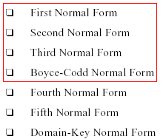
III.2. Normal Forms

Slide 17
First normal form1NF
1NF A relation R is in first normal form (1NF)
if and only if
all underlying domains contain atomic values only.
Is it 1NF?
Notes:
atomic values:
=one value for an attribute
= no repeating groups
= no multivalued attributes
= no composite attributes

Slide 18
No 1NF. There are repeating groups (subject, subjectcost, grade)
1NF
How can you make it 1NF?

Slide 19

Create new rows so each cell contains only one value
1NF
But now look – is the studentID primary key still valid?

Slide 20
No – the studentID no longer uniquely identifies each row
1NF
You now need to declare studentID and subject together to uniquely identify each row.
So the new key is StudentID and Subject.

Slide 21
So. We now have 1NF.
1NF
Is it 2NF?

Slide 22
Second normal form 2NF
A relation R is in 2NF
if and only if
it is in 1NF and every non-key attribute is fully dependent on the primary key

Slide 23
2NF
StudentName & Address are dependent on studentID (which is part of the key)
But they are not dependent on Subject (the other part of the key)

Slide 24
And 2NF requires…
2NF
All non-key fields are dependent on the ENTIRE key (studentID + subject)

Slide 25
So it’s not 2NF
How can we fix it?

Slide 26
Convert to 2NF

Slide 27
Make new tables
2NF
Make a new table for each primary key field
Give each new table its own primary key
Move columns from the original table to the new table that matches their primary key…

Slide 28
Step 1
convert to 2NF
STUDENT TABLE (key = StudentID)

Slide 29

Step 2
convert to 2NF
STUDENT TABLE (key = StudentID)
SUBJECTS TABLE (key = Subject)

Slide 30



Step 3
convert to 2NF
STUDENT TABLE (key = StudentID)
RESULTS TABLE (key = StudentID+Subject)
SUBJECTS TABLE (key = Subject)

Slide 31
Step 4 - relationships
convert to 2NF
STUDENT TABLE (key = StudentID)
SUBJECTS TABLE (key = Subject)
RESULTS TABLE (key = StudentID+Subject)

Slide 32
Each student can only appear ONCE in the student table
STUDENT TABLE (key = StudentID)
SUBJECTS TABLE (key = Subject)
RESULTS TABLE (key = StudentID+Subject)

Slide 33
Each subject can only appear ONCE in the subjects table
STUDENT TABLE (key = StudentID)
SUBJECTS TABLE (key = Subject)
RESULTS TABLE (key = StudentID+Subject)

Slide 34
A subject can be listed MANY times in the results table (for different students)
STUDENT TABLE (key = StudentID)
SUBJECTS TABLE (key = Subject)
RESULTS TABLE (key = StudentID+Subject)

Slide 35
A student can be listed MANY times in the results table (for different subjects)
STUDENT TABLE (key = StudentID)
SUBJECTS TABLE (key = Subject)
RESULTS TABLE (key = StudentID+Subject)

Slide 36
SubjectCost is only dependent on the primary key,
Subject
STUDENT TABLE (key = StudentID)
SUBJECTS TABLE (key = Subject)
RESULTS TABLE (key = StudentID+Subject)

Slide 37
2NF check
STUDENT TABLE (key = StudentID)
SUBJECTS TABLE (key = Subject)
1
1
8
8
Grade is only dependent on the primary key (studentID + subject)
RESULTS TABLE (key = StudentID+Subject)

Slide 38
2NF check
STUDENT TABLE (key = StudentID)
SUBJECTS TABLE (key = Subject)
1
Name, Address are only dependent on the primary key
(StudentID)
1
8
8
RESULTS TABLE (key = StudentID+Subject)

Slide 39
But is it 3NF?
So it is 2NF!
STUDENT TABLE (key = StudentID)
1
1
SUBJECTS TABLE (key = Subject)
8
8
RESULTS TABLE (key = StudentID+Subject)

Slide 40
Third normal form 3NF
A relation R is in 3NF
if and only if
it is in 2NF and every non-key attribute is non-transitively dependent on the primary key

Slide 41
Third normal form 3NF
An attribute C is transitively dependent on attribute A if there exists an attribute B such that:
A->B and B->C

Slide 42
3NF
Note that
3NF is concerned with transitive dependencies (which do not involve candidate keys).
A relation with more than one candidate key will clearly have transitive dependencies of the form:
primary_key -> other_candidate_key -> any_non-key_column

Slide 43
STUDENT TABLE (key = StudentID)
SUBJECTS TABLE (key = Subject)
8
1
8
RESULTS TABLE (key = StudentID+Subject)

Slide 44
3NF check
STUDENT TABLE (key = StudentID)
StudentID-> HouseName
and
HouseName-> HouseColour
1
SUBJECTS TABLE (key = Subject)
1
8
8
RESULTS TABLE (key = StudentID+Subject)

Slide 45
3NF check
STUDENT TABLE (key = StudentID)
But either way,
non-key fields are dependent on MORE THAN THE PRIMARY KEY (studentID)
1
SUBJECTS TABLE (key = Subject)
1
8
8
RESULTS TABLE (key = StudentID+Subject)

Slide 46
3NF check
STUDENT TABLE (key = StudentID)
And 3NF says that non-key fields must depend on nothing but the key
1
SUBJECTS TABLE (key = Subject)
1
8
8
RESULTS TABLE (key = StudentID+Subject)

Slide 47
3NF check
STUDENT TABLE (key = StudentID)
WHAT DO WE DO?
1
SUBJECTS TABLE (key = Subject)
1
8
8
RESULTS TABLE (key = StudentID+Subject)

Slide 48

Again, carve off the offending fields
1
SUBJECTS TABLE (key = Subject)
8
8
1
RESULTS TABLE (key = StudentID+Subject)

Slide 49

3NF fix
1
8
SUBJECTS TABLE (key = Subject)
8
1
RESULTS TABLE (key = StudentID+Subject)

Slide 50
3NF fix
8
1
1
SUBJECTS TABLE (key = Subject)
8
8
1
RESULTS TABLE (key = StudentID+Subject)

Slide 51
3NF fix
Or…

Slide 52
3NF fix
8
1
1
8
8
1
RESULTS TABLE (key = StudentID+Subject)
SUBJECTS TABLE (key = Subject)
Or…

Slide 53
The Reveal
Before…
After…
1
8
1
1
8
8
SUBJECTS TABLE (key = Subject)
RESULTS TABLE (key = StudentID+Subject)

Slide 54
BCNF
A relation R is in BCNF if and only if: Whenever there is a Non-Trivial FD X ->Y for R, it is the case that: {X} is a super-key for R
That is: the left side of every Non-Trivial FD must be a super-key
Notes:
Non-trivial FD: phu thuoc tam thuong
Boyce-Codd Normal Form is violated if:
Third Normal Form is violated
If there exists a partial key which is functionally dependent on a non-key field(s).
non-key → partial-key

Slide 55
BCNF decomposition algorithm (self studying)
Input: A relation R with a set of FD’s F
Output: A BCNF decomposition of R with lossless join
Method:
At each step compute the key for the sub-relation R
if not in BCNF, pick any FD X->Y which violates
break the relation into 2 sub-relations
R1(XY)
R2(S - Y)
this has a lossless join project FD's onto each sub-relation
continue until no more offending FD's

Slide 56
3NF decomposition algorithm – self studying
Input: A relation R with a set of FD’s F
Output: A decomposition of R into a collection of relations, all of which are in 3NF. This decomposition has a lossless join and dependency-preservation.
Method:
Find minimal basic for F, say G.
∀ X-A ∈ G, use XA as the schema of one relations in the decomposition.
If none of the sets of relations from Step 2 is a super key for R, add another relation whose schema is a key for R.

Slide 57
SUMMARY 1
Decompose a relation into BCNF is a solution for eliminating anomalies
But BCNF can cause information loss and dependency loss
3NF is a relax solution of BCNF that keep loss-less join and dependency-preservation properties

Slide 58
Summary 2:
2NF | 3NF | Boyce-Codd
every nonprime attribute A in R is not partially dependent on any key of R | a nontrivial functional dependency: X => A holds in R, either X is a superkey of R, or (b) A is a prime attribute of R. | a nontrivial functional dependency X => A holds in R, then: X is a superkey of R
Note:A functional dependency X => Y is a full functional dependency if removal of any attribute A from X means that the dependency does not hold any more; A partial functional dependency is not a full functional dependency

Slide 59
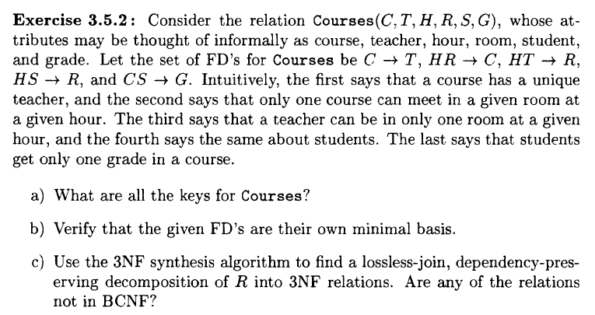
EXERCISE 1

Slide 60
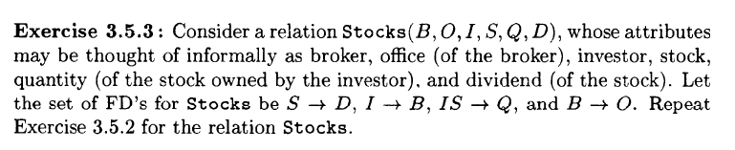
EXERCISE 2

